Slide 1
Lecture 28

Slide 2
v_{t}
v_{b}

Slide 3
v_{t}
v_{b}

Slide 4
v_{t}
v_{b}

Slide 5
A
F
v
v=0
Δy

Slide 6
Pressure
In
Pressure
Out
A
A

Slide 8
End

Slide 10
Question 123.12.1.1
I have a sample of a substance with a heat capacity of 100J/K. How much heat can this sample hold if it is at 2000K?
2000000J
20J
0.5J
None at all

Slide 11



Slide 12
ΔT
Q

Slide 14
Specific Heat
Every substance requires a unique amount of energy per unit mass to change the temperature of that substance by 1° C
The specific heat, c, of a substance is a measure of this amount

Slide 15
Units of Specific Heat
SI units
J / kg °C
Historical units
cal / g °C

Slide 17
Heat and Specific Heat
Q = m c ΔT
ΔT is always the final temperature minus the initial temperature
When the temperature increases, ΔT and ΔQ are considered to be positive and energy flows into the system
When the temperature decreases, ΔT and ΔQ are considered to be negative and energy flows out of the system

Slide 18
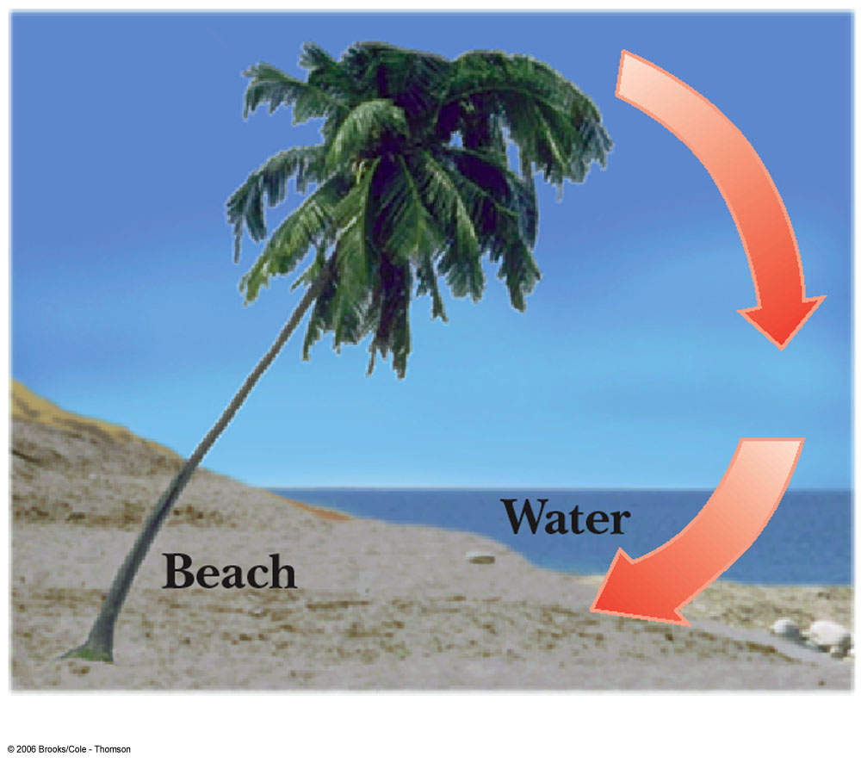
A Consequence of Different Specific Heats
Water has a high specific heat compared to land
On a hot day, the air above the land warms faster
The warmer air flows upward and cooler air moves toward the beach

Slide 19
Question 123.12.2
You add energy to an object by heat transfer. At some point, the temperature of the object stops rising. What is happening?
The system is leaking thermal energy
The system has as much heat as it can take
The object is experiencing a phase change
Can’t tell

Slide 20
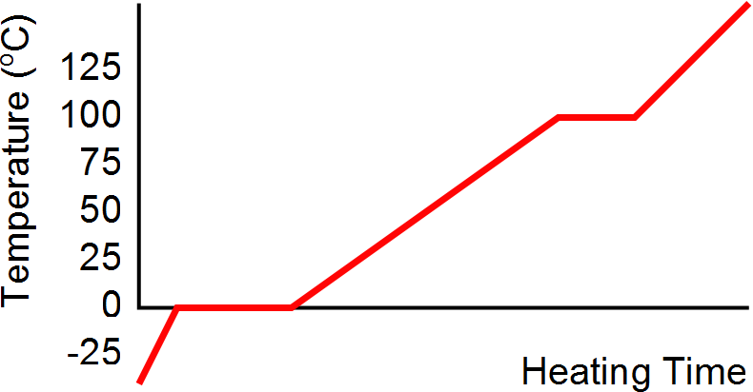
Heating Ice
Gaseous steam
Boiling water
Liquid water
Melting ice
Solid ice

Slide 21
Graph of Ice to Steam
T(ºC)
150
120
90
60
30
0
-30
Steam
Water and Steam
Water
Ice and water
0 500 1000 1500 2000 2500 3000
Ice
Energy added (J)

Slide 22
20.3 Latent Heat

Slide 23
Phase Changes
A phase change occurs when the physical characteristics of the substance change from one form to another
Common phases changes are
Solid to liquid – melting
Liquid to gas – boiling
Phases changes involve a change in the internal energy, but no change in temperature

Slide 24
Latent Heat
During a phase change, the amount of heat is given as
Q = ±m L
L is the latent heat of the substance
Latent means hidden
L depends on the substance and the nature of the phase change
Choose a positive sign if you are adding energy to the system and a negative sign if energy is being removed from the system

Slide 25
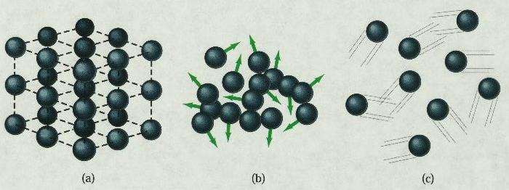
Phase Changes Latent Heat
Solid
Liquid
Gas
During a phase change, the internal energy changes but the temperature does not change.
Work is done against the attractive molecular forces to separate them.

Slide 26
Latent Heat, cont.
SI units of latent heat are J / kg
Latent heat of fusion, L_{f}, is used for melting or freezing
Latent heat of vaporization, L_{v}, is used for boiling or condensing
Table 11.2 gives the latent heats for various substances

Slide 27
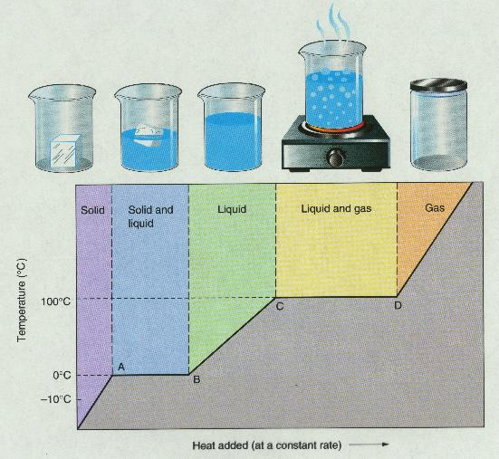
T vs. Q Graphs

Slide 29
Graph of Ice to Steam
T(ºC)
150
120
90
60
30
0
-30
Steam
Water and Steam
Water
Ice and water
0 500 1000 1500 2000 2500 3000
Ice
Energy added (J)

Slide 30
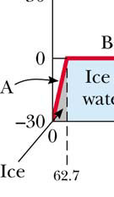
Warming Ice
Start with one gram of ice at –30.0º C
During A, the temperature of the ice changes from –30.0º C to 0º C
Use Q = m c ΔT
Will add 62.7 J of energy

Slide 31
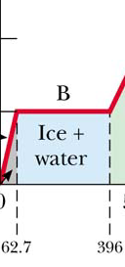
Melting Ice
Once at 0º C, the phase change (melting) starts
The temperature stays the same although energy is still being added
Use Q = m L_{f}
Needs 333 J of energy

Slide 32
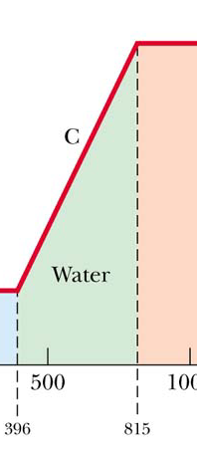
Warming Water
Between 0º C and 100º C, the material is liquid and no phase changes take place
Energy added increases the temperature
Use Q = m c ΔT
419 J of energy are added

Slide 33
Question 123.12.3
Will spaghetti cook faster if the water is boiling faster?
Yes
No
What is Spaghetti? I only eat Raman

Slide 34
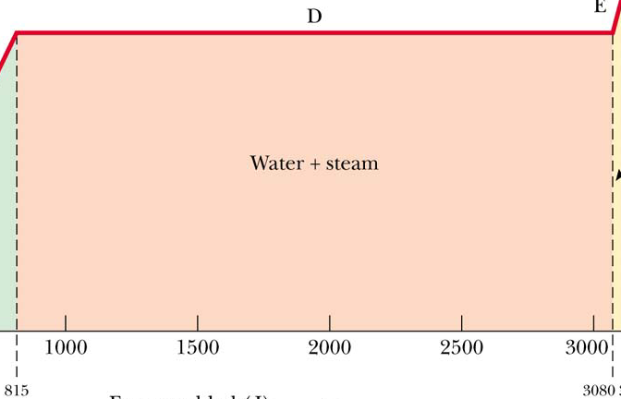
Boiling Water
At 100º C, a phase change occurs (boiling)
Temperature does not change
Use Q = m Lv
2 260 J of energy are needed

Slide 35
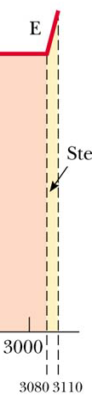
Heating Steam
After all the water is converted to steam, the steam will heat up
No phase change occurs
The added energy goes to increasing the temperature
Use Q = m c ΔT
To raise the temperature of the steam to 120°, 40.2 J of energy are needed

Slide 36
Question 123.12.4
You put 1 kg of ice at 0ºC together with 1 kg of water at 50ºC. What is the final temperature?
L_{F} = 3.33 x 10⁵ J/kg
c_{water} = 4190 J/(kg K)
a) 0ºC
b) between 0ºC and 50ºC
c) 50ºC
d) greater than 50ºC

Slide 37
Question 123.12.5
1 kg of water at 100 ºC is poured into a bucket that contains 4 kg of water at 0 ºC. Find the equilibrium temperature (neglect the influence of the bucket).
a) 0 ºC
b) 20 ºC
c) 50 ºC
d) 80 ºC
e) 100 ºC

Slide 38
Problem Solving Strategies
Make a table
A column for each quantity
A row for each phase and/or phase change
Use a final column for the combination of quantities
Use consistent units

Slide 39
Problem Solving Strategies, cont
Apply Conservation of Energy
Transfers in energy are given as Q=mcΔT for processes with no phase changes
Use Q = m L_{f} or Q = m L_{v} if there is a phase change
In Q_{cold} = - Q_{hot} be careful of sign
ΔT is T_{f} – T_{i}
Solve for the unknown

Slide 40
Calorimeter
One technique for determining the specific heat of a substance
A calorimeter is a vessel that is a good insulator which allows a thermal equilibrium to be achieved between substances without any energy loss to the environment

Slide 41
Calorimetry
Analysis performed using a calorimeter
Conservation of energy applies to the isolated system
The energy that leaves the warmer substance equals the energy that enters the water
Q_{cold} = -Q_{hot}
Negative sign keeps consistency in the sign convention of ΔT

Slide 42
Calorimeter
Sample at known temperature T_{x}
Water temperature rises
Water at known temperature T_{w}
Insulated container

Slide 43
Calorimetry
Object #1
Object #2

Slide 44
Calorimetry
Object #1
Object #2

Slide 45
Mixture Example
200 cm³ of hot water at 95ºC is poured into a 150 g glass cup initially at 25ºC. What is the final temperature of the mixture when equilibrium is reached, assuming no heat flows to the surroundings.

Slide 46
Mixture Example
200 g
What is the mass of 200 cm³ of water?

Slide 47
Calorimeter
Sample at known temperature T_{x}
Water temperature falls
Water at known temperature T_{w}
Insulated container

